Slide 1
Week 11a
COMPUTATIONAL MATHEMATICS
ODE and Euler Method

Slide 2
Reference
Kisualaas, Jann. (2013). Numerical Methods in Engineering with Python 3. Cambridge University Press.
Johansson, Robert. (2015). Chapter 5. Equation Solving. Numerical Python: A Practical Techniques Approach for Industry, Apress.
Chapra, S. C., and Raymond P. Canale. (2010). Numerical methods for engineers, Sixth edition, McGraw Hill.
Kaw, A. (n.d.). Numerical Methods. Retrieved March 20, 2020, from https://nm.mathforcollege.com/

Slide 3
Ordinary Differential Equations (ODE)
Equations which are composed of an unknown function and its derivatives are called differential equations.
Differential equations play a fundamental role in engineering because many physical phenomena are best formulated mathematically in terms of their rate of change.
v: dependent variable
t: independent variable

Slide 4
Partial Differential Equations (PDE)
When a function involves one dependent variable, the equation is called an ordinary differential equation (or ODE). A partial differential equation (or PDE) involves two or more independent variables.
Differential equations are also classified as to their order.
A first order equation includes a first derivative as its highest derivative.
A second order equation includes a second derivative.
Higher order equations can be reduced to a system of first order equations, by redefining a variable.

Slide 5
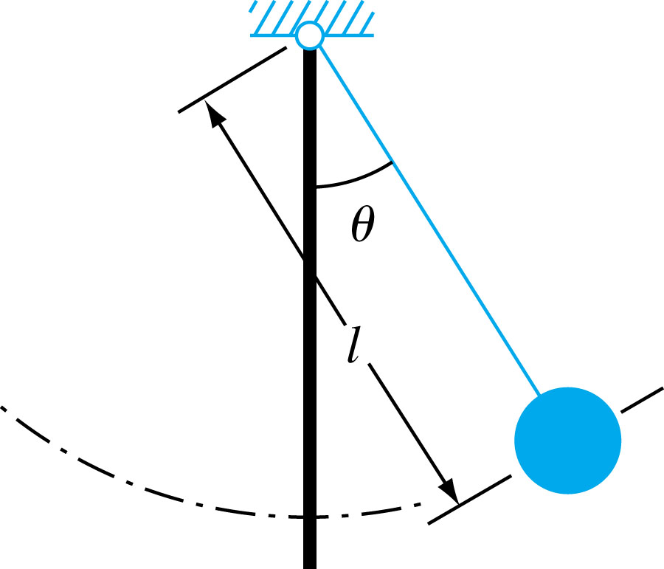
ODEs and Engineering Practice

Slide 6
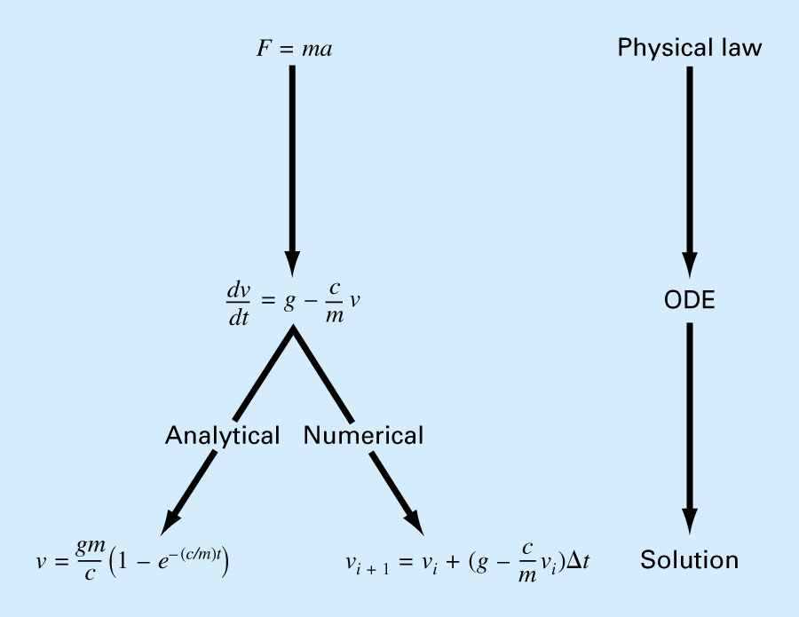
What is the value of v at t = a if we have dv/dt at t = t0 is v0?

Slide 7
Another Example
A rectifier-based power supply requires a capacitor to temporarily store power when the rectified waveform from the AC source drops below the target voltage. To properly size this capacitor a first-order ordinary differential equation must be solved. For a particular power supply, with a capacitor of , the ordinary differential equation to be solved is
find the voltage across the capacitor at t = 0.00004 s

Slide 8
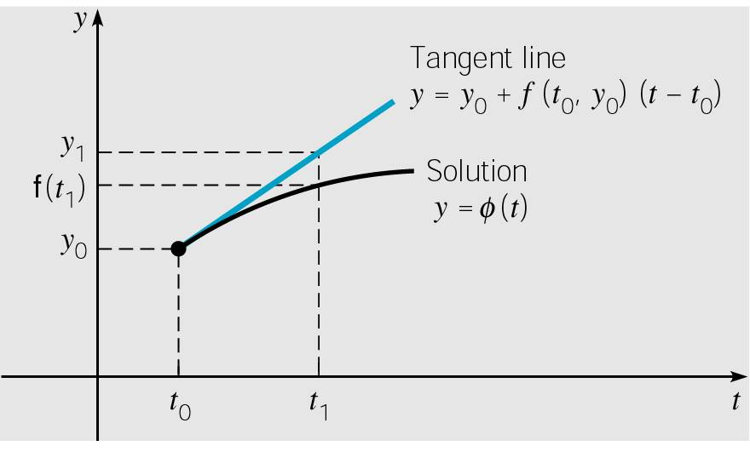
Euler’s Method for Solving Initial Value Problem
Initial value problem:
we begin by approximating solution y = φ(t) at initial point t₀.
The solution passes through initial point (t₀, y₀) with slope
f (t₀, y₀). The line tangent to solution at initial point is thus
The tangent line is a good approximation to solution curve on an interval short enough.
Thus if t₁ is close enough to t₀,
we can approximate φ(t₁) by

Slide 9
Euler’s Method
y
Slope
True value
y₁, Predicted
value
x₀,y₀
Φ
Step size, h
x
Figure 1 Graphical interpretation of the first step of Euler’s method

Slide 10
Euler’s Method
y
True Value
y_{i+1}, Predicted value
y_{i}
Φ
h
Step size
x_{i}
x_{i+1}
x
Figure 2. General graphical interpretation of Euler’s method

Slide 11
How to write Ordinary Differential Equation
How does one write a first order differential equation in the form of
Example
is rewritten as
In this case

Slide 12
Example
A ball at 1200K is allowed to cool down in air at an ambient temperature of 300K. Assuming heat is lost only due to radiation, the differential equation for the temperature of the ball is given by
Find the temperature at
seconds using Euler’s method. Assume a step size of
seconds.

Slide 13
Solution
Step 1:
is the approximate temperature at

Slide 14
Solution Cont
Step 2:
For
is the approximate temperature at

Slide 15
Solution Cont
The exact solution of the ordinary differential equation is given by the solution of a non-linear equation as
The solution to this nonlinear equation at t=480 seconds is

Slide 16
Comparison of Exact and Numerical Solutions
Figure 3. Comparing exact and Euler’s method

Slide 17
Effect of step size
Table 1. Temperature at 480 seconds as a function of step size, h
Step, h | θ(480) | E_{t} | |є_{t}|%
480 240 120 60 30 | −987.81 110.32 546.77 614.97 632.77 | 1635.4 537.26 100.80 32.607 14.806 | 252.54 82.964 15.566 5.0352 2.2864
(exact)

Slide 18
Comparison with exact results
Figure 4. Comparison of Euler’s method with exact solution for different step sizes

Slide 19
Effects of step size on Euler’s Method
Figure 5. Effect of step size in Euler’s method.

Slide 20
Errors in Euler’s Method
It can be seen that Euler’s method has large errors. This can be illustrated using Taylor series.
As you can see the first two terms of the Taylor series
are the Euler’s method.
The true error in the approximation is given by

